Slide 1

Telegram bot
Famalo
PROJECT BY
ADHITHYAN.V.P
Your All in one bot

Slide 2


INTRODUCTION
AIM
CURRENT SYSTEM STUDY
GAP BETWEEN CS & PS
TABLE OF CONTENTS
ADVANTAGES
DISADVANTAGES
WORKING DIAGRAM
MODULE AND FEATURES
SCREENSHOTS
FUTURE SCOPE
CONCLUSION
REFERENCES

Slide 3
INTRODUCTION
Famalo is ultimate Telegram Bot Companion, providing a range of features to meet your diverse needs
Whether you’re a student,professional, or simply looking for entertainment, Famalo has something for everyone

Slide 4
AIM
To create a telegram bot with 'telebot' framework that can do various tasks. A bot with multiple features which can be very useful in real-life and also some fun features that cheer you up.

Slide 5
CURRENT SYSTEM STUDY
Open a web browser
Search for your desired feature
Find a website from the ocean of links
Open a website
Sign up with that strange website
Share your private information(like email)
Wait for OTP verification
Log in
Pay a plan if needed(more information like credit card)
Complex use of website if user is new
Time waste in understanding the layout of that website
If that website doesn’t do what you wanted, do all these again with another website

Slide 6
GAP BETWEEN CS AND PS
Open FAMALO chat interface from telegram
Input your feature as a text message
Famalo will detect the feature
Done

Slide 7
ADVANTAGES
Friend like interactions
Quick access
A chat platform which is easy to use and get used to.
Reduce boredom
Complex features simplified

Slide 8
DISADVANTAGES
A lot of features ,which may be overwhelming
Commands in telegram at first may be confusing to use for newbies

Slide 9
WORKING DIAGRAM
START
MAIN MENU
EDUCATION
CALCULATORS
GENERATORS
REAL LIFE
ST. THOMAS COLLEGE
SYSTEM-BASED
FUN
FEATURE 1-N
FEATURE 1-N
FEATURE 1-N
FEATURE 1-N
FEATURE 1-N
FEATURE 1-N
FEATURE 1-N

Slide 10
MODULES AND FEATURES
Auto Feature Detection
Education
Online Course Recommendator
Youtube Course Recommendator
Cheatsheets
Github learning Resources
Calculators
External mark needed for specific grade
Playbackspeed Calculator
ST thomas college specific
Syllabus sender
Generators
Password Generator
Text to audio Converter
QR code Generator
Morse code Generator
Real Life
Weather details of your current location
Random Activity
System based
Linux distro recommendator
Linux Commands pdf

Slide 11
FUN
Random Jokes
Dice simulator
Corporate BS
Superhero Details
Random Meme Generator

Slide 12
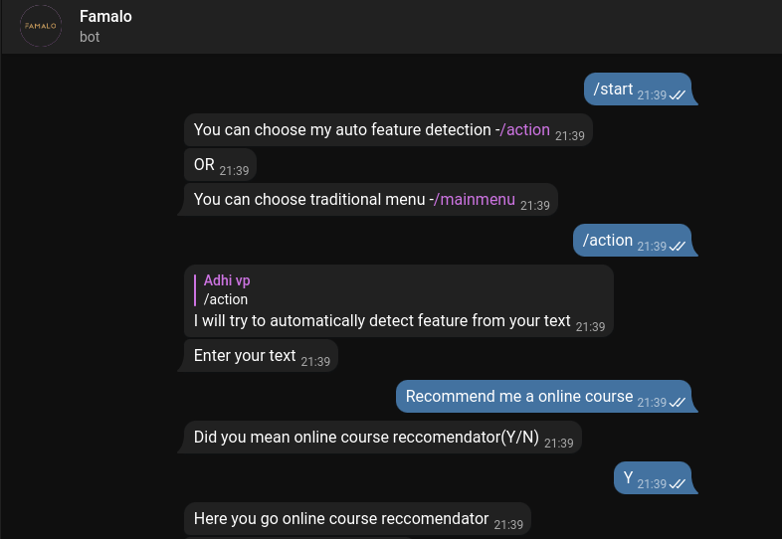
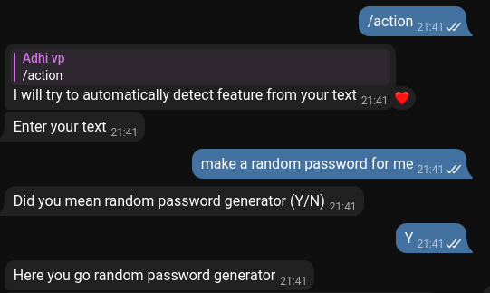
SCREENSHOTS
Auto Feature Detection

Slide 13
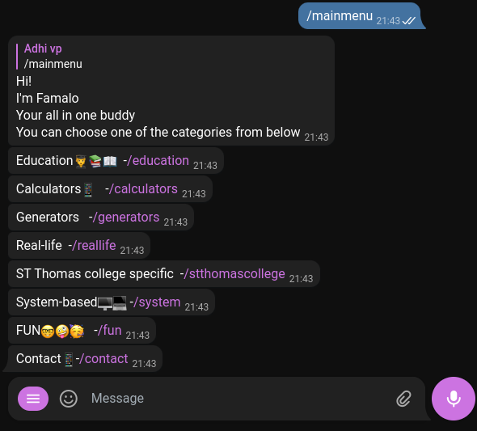
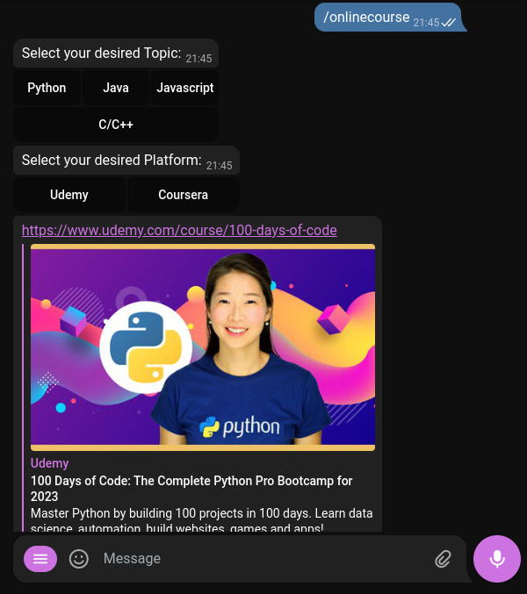
Main Menu
Online course recommendator

Slide 14

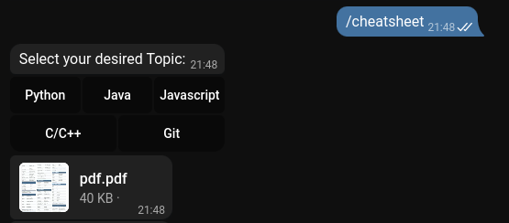
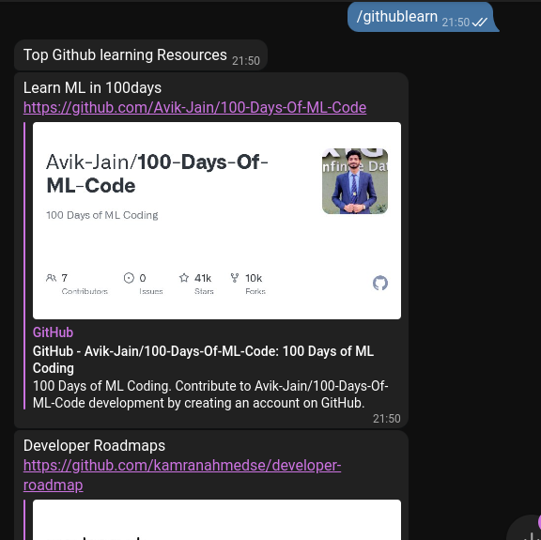
Youtube course recommendator
Cheatsheets
Github learning resources

Slide 15
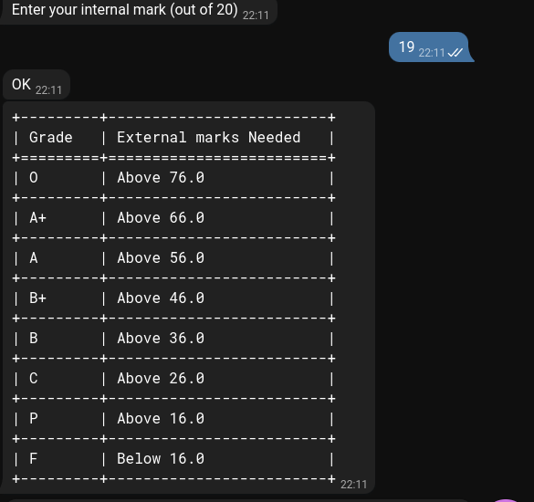
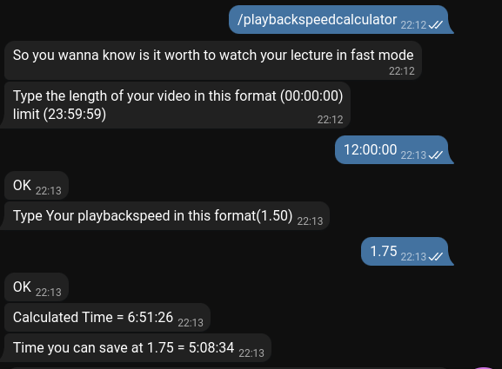
External mark needed for a specific grade
Playbackspeed Calculator

Slide 16
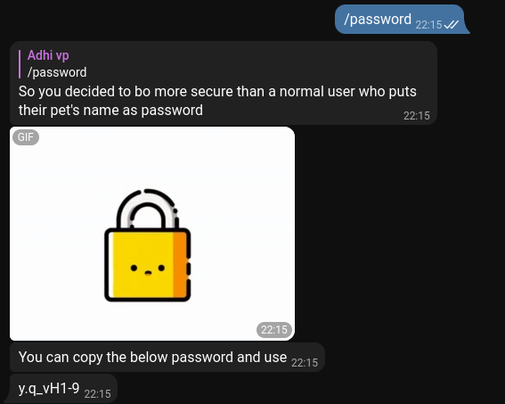
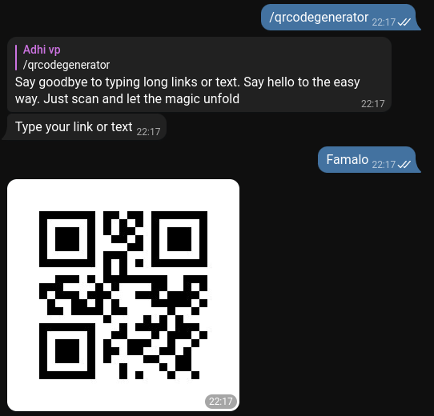
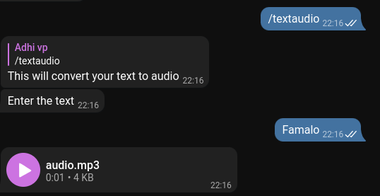
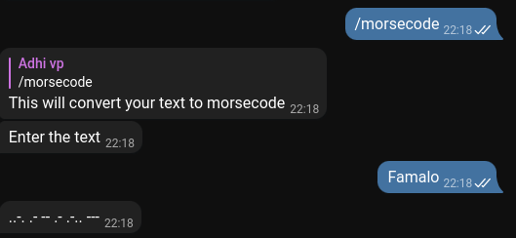
Password Generator
QR code generator
Text to Audio Converter
Morse code generator

Slide 17
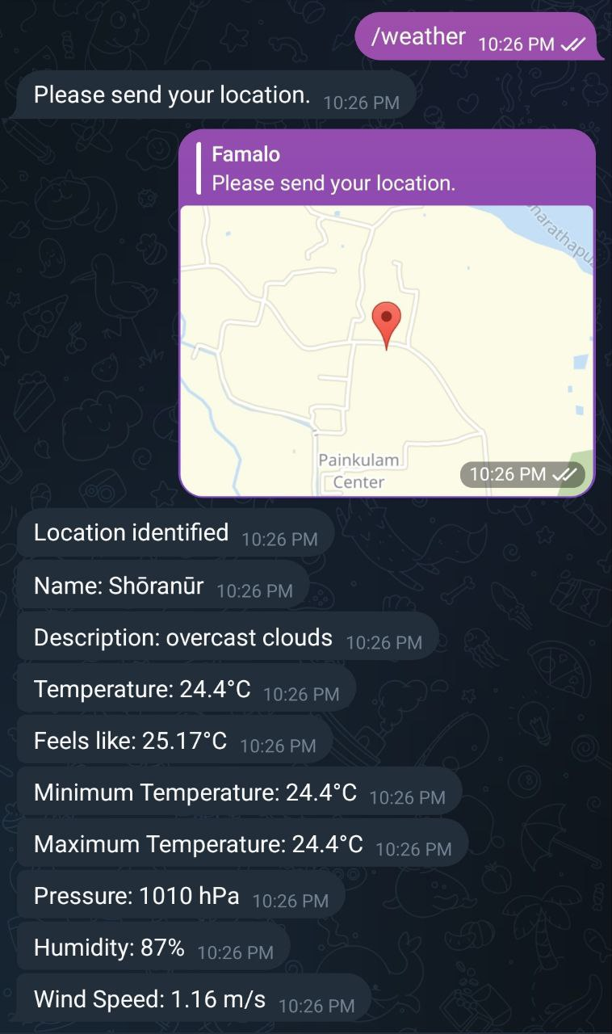
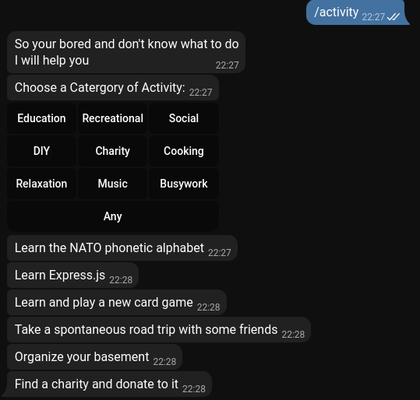
Weather of your current location
Random Activity Generator

Slide 18
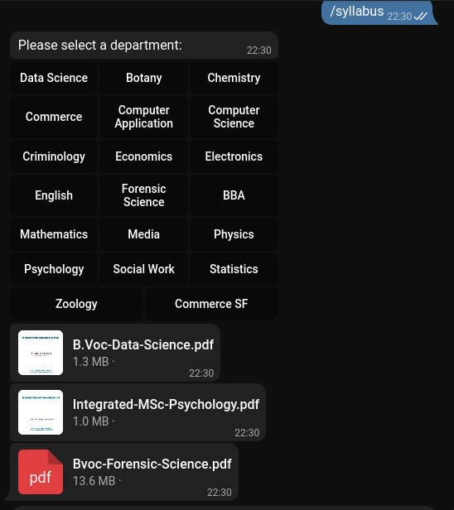
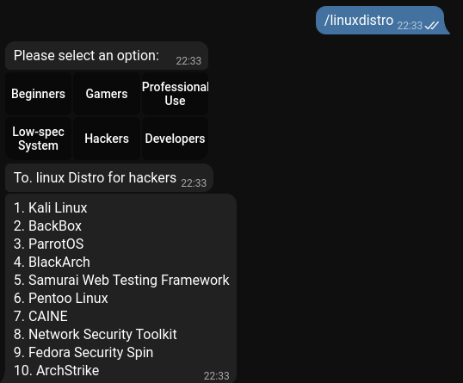
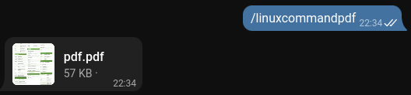
Syllabus Sender
Linux distro recommendator
Linux commands pdf

Slide 19
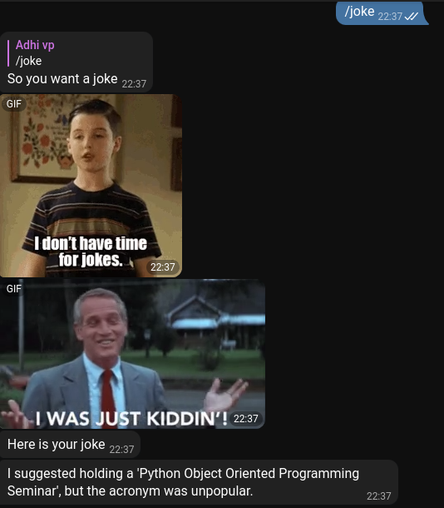

Random Jokes
Dice simulator

Slide 20
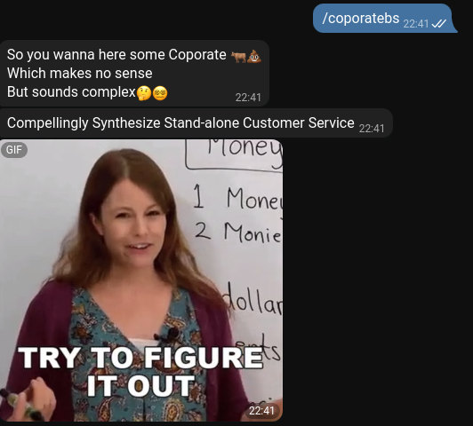
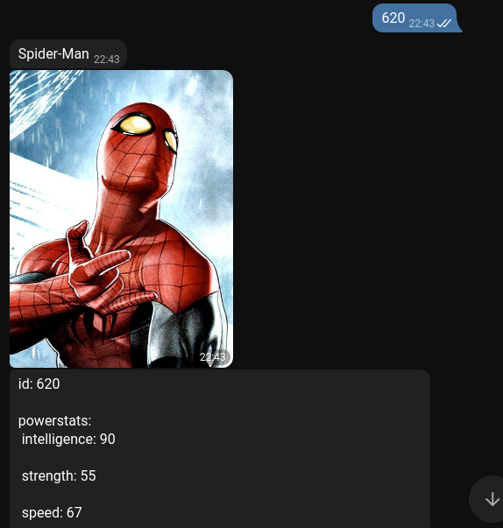
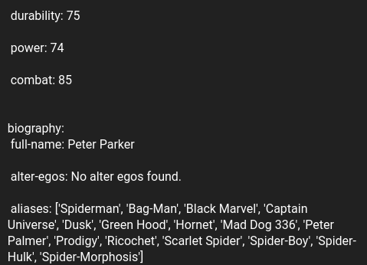
Corporate BS
Superhero Details

Slide 21
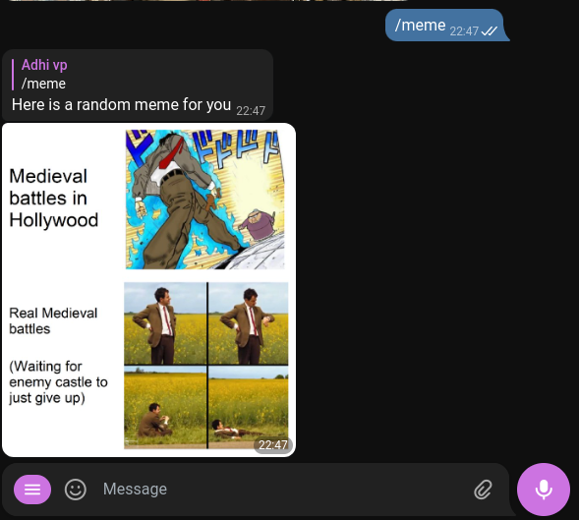
MEME Generator

Slide 22
FUTURE SCOPE
To create a completely new LLM model for this purpose , which can do infinite number of tasks.

Slide 23
CONCLUSION
In conclusion, Famalo is a versatile and efficient tool that simplifies various tasks and enhances user experience, making it an valuable asset for users seeking convenience and functionality in a single platform.
Unlock a new level of convenience and productivity with Famalo

Slide 24
REFERENCES
Telegram - https://core.telegram.org/bots/api
Main Framework - https://pypi.org/project/pyTelegramBotAPI/
Features
https://pypi.org/project/pyjokes/
https://pypi.org/project/gTTS/
https://pypi.org/project/PyQRCode/
https://pypi.org/project/random-password-generator/
https://github.com/D3vd/Meme_Api
https://openweathermap.org/api
https://www.boredapi.com/
https://stthomas.ac.in/
https://github.com/sameerkumar18/corporate-bs-generator-api
https://www.superheroapi.com/

Slide 25
THANK YOU!

